Slide 1

AWS re:invent 2017 Getting started with AWS Aurora summary and highlights
by Atanas Kuzmanov
15-December-2017

Slide 2

What is AWS Aurora?
Fully managed relational database service optimised for the cloud.
From a user's perspective:
Speed and availability of high-end commercial databases
Simplicity and cost-effectiveness of open source databases
Compatibility with MySQL and PostgreSQL
Simple pay as you go pricing

Slide 3
What is AWS Aurora?
From a technical perspective:
Scale-out and distributed design
Service-oriented architecture integrated with AWS services
Automate administrative tasks

Slide 4
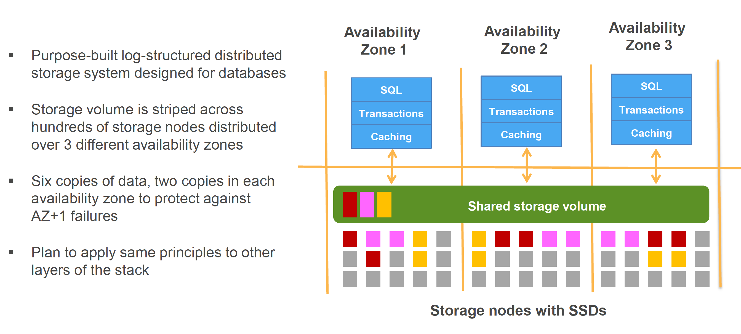
Scale-out, distributed architecture

Slide 5
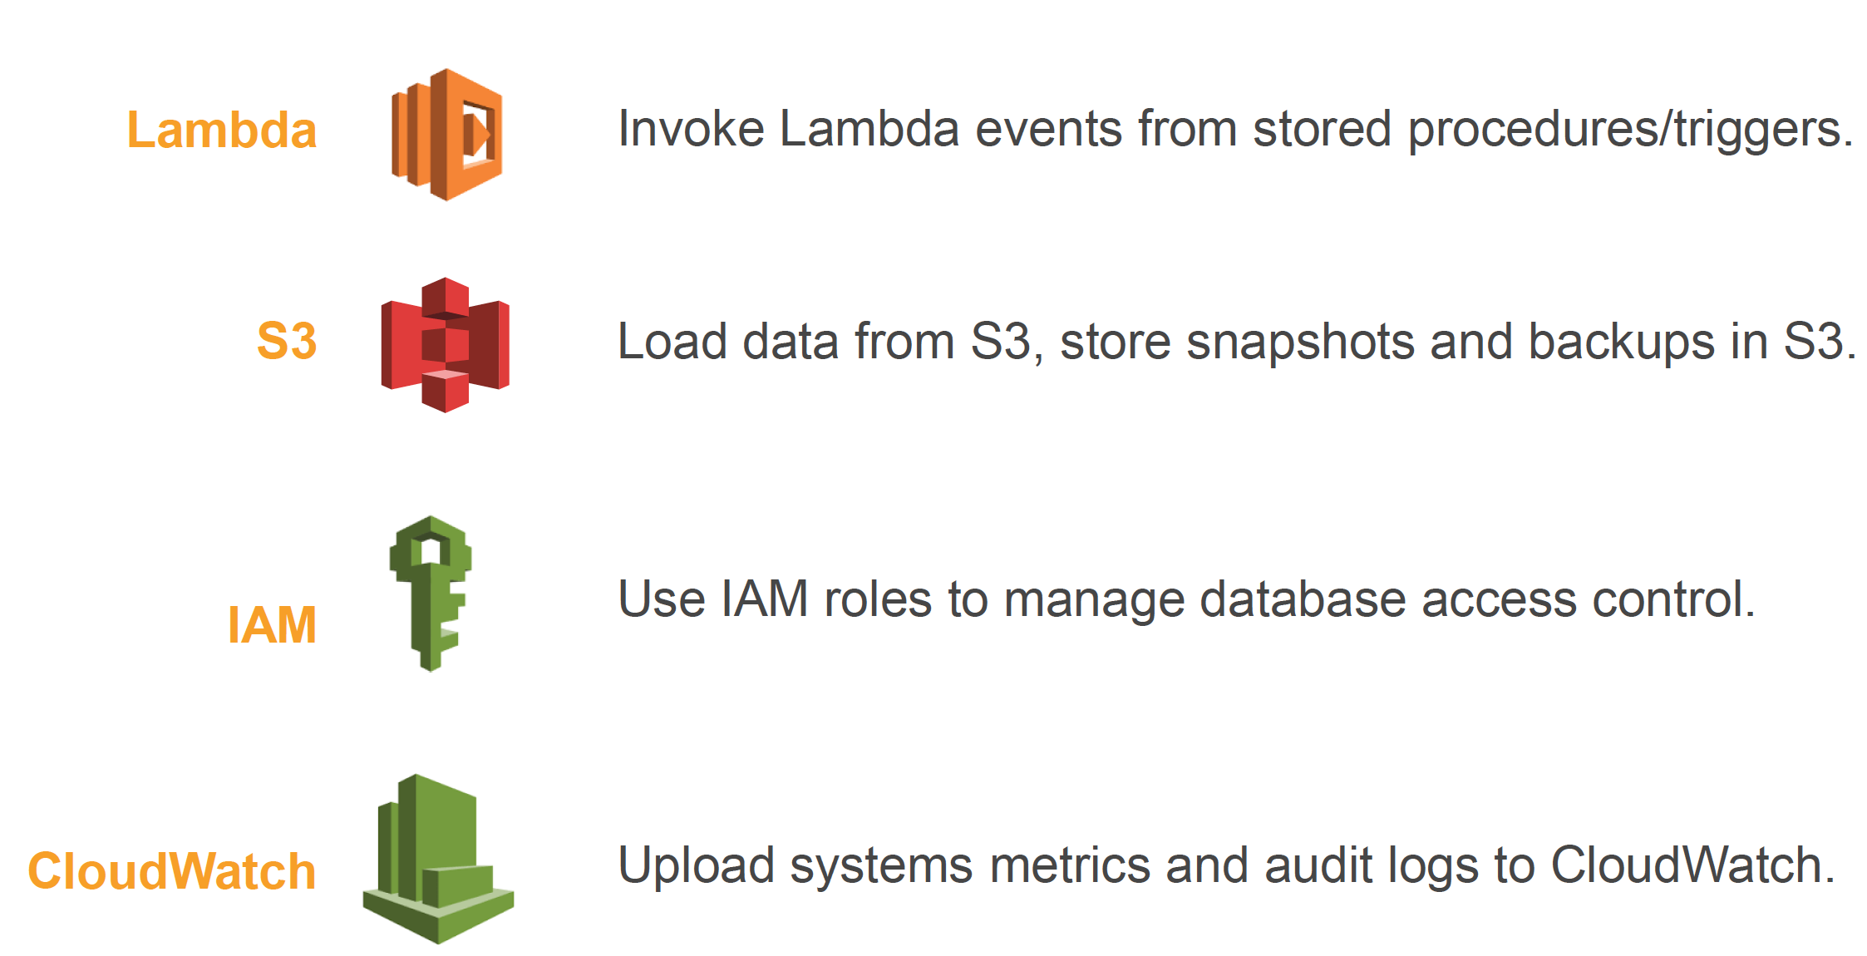
Integrated with the cloud ecosystem

Slide 6
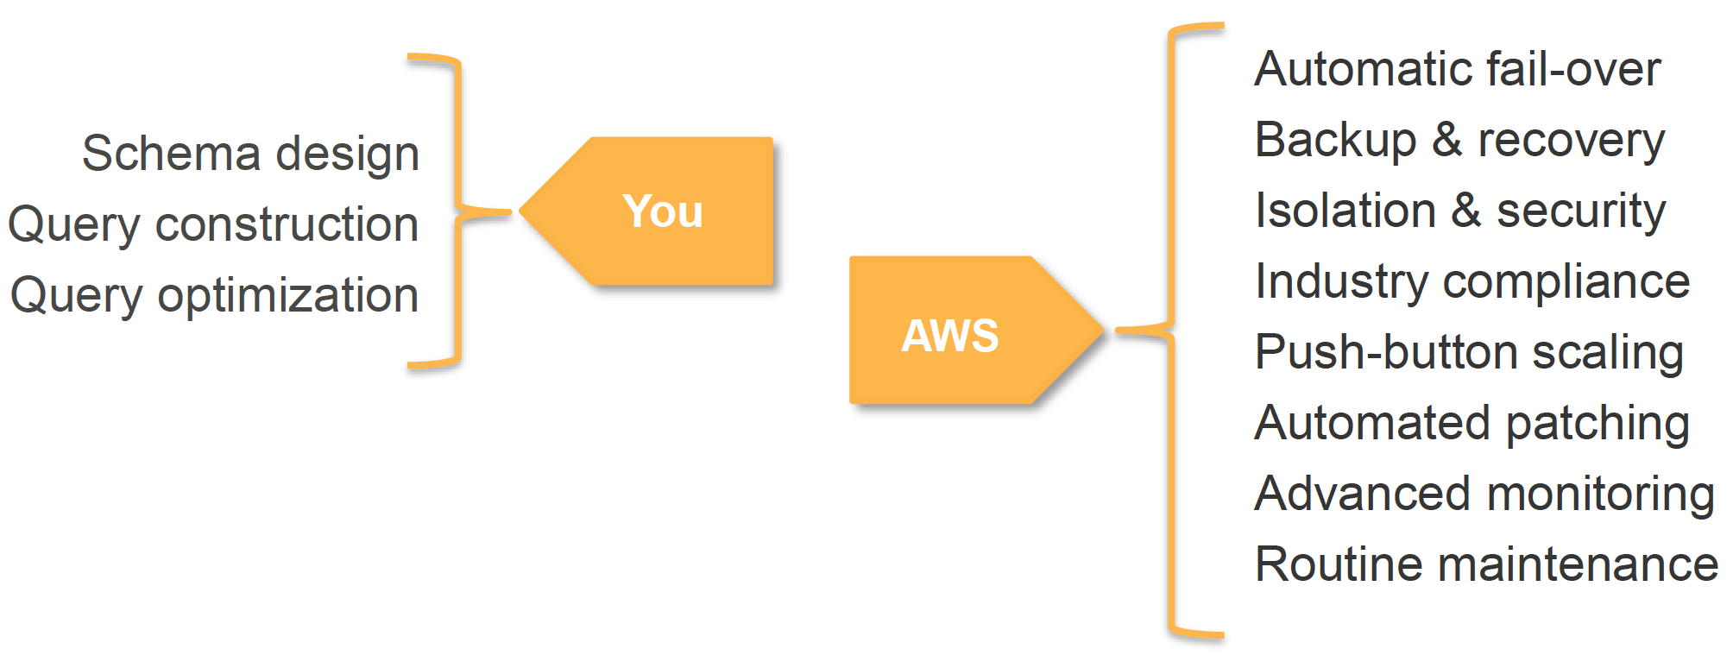
Automation

Slide 7
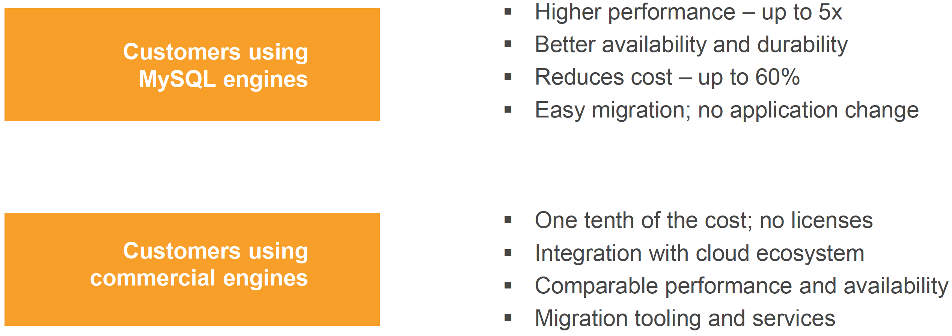
Why use Aurora?

Slide 8
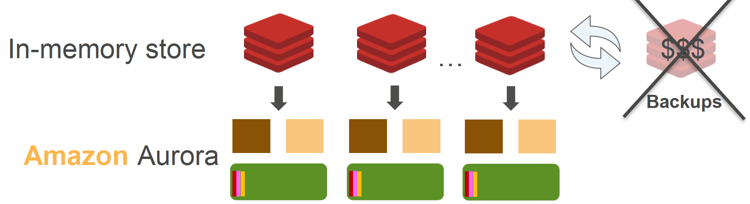
Use case examples
Highly-available persistent data store
Notes:
Using Redis cluster to store metadata
Needs backups
As data grows backups become expensive and complicated
Replaced backup infrastructure with Aurora cluster behind Redis cluster
Management & cost improvement

Slide 9
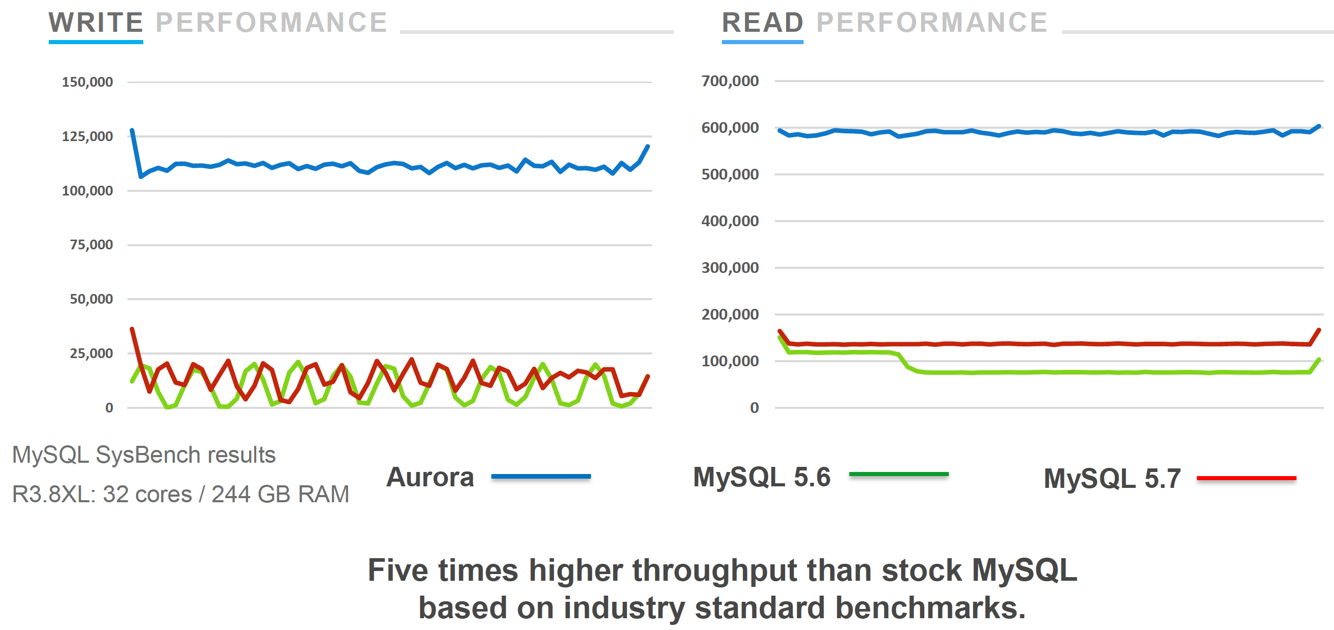
Aurora is fast
5 x faster than RDS MySQL 5.6 & 5.7

Slide 10
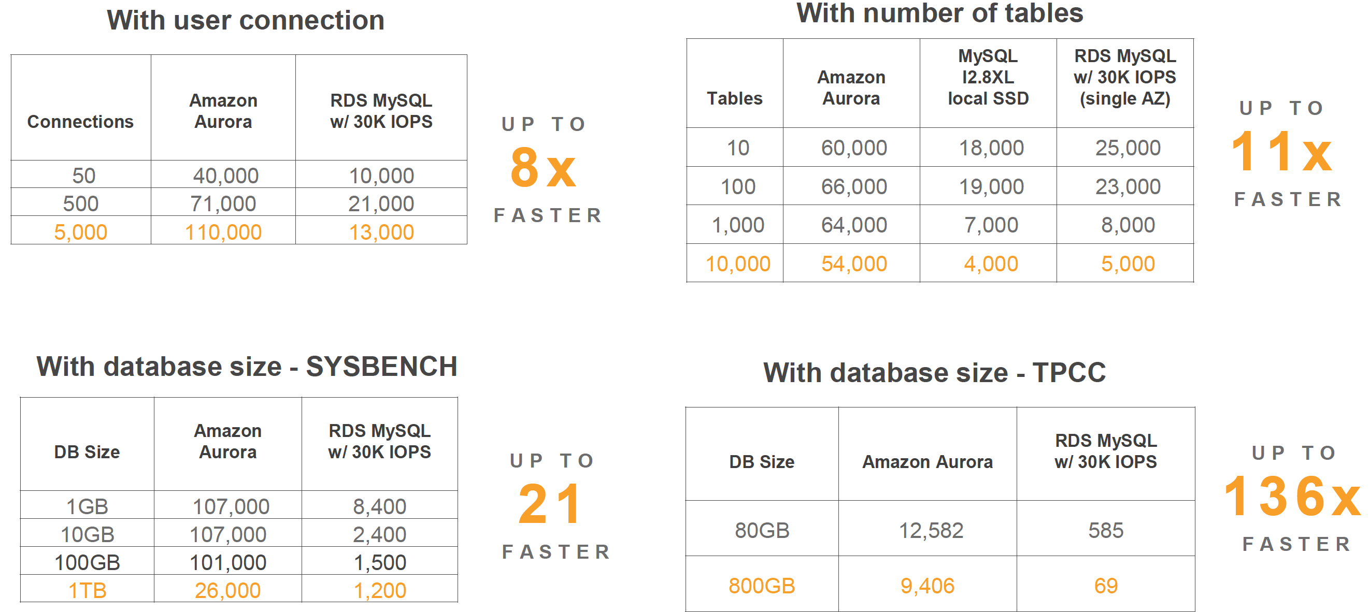
Aurora scales well

Slide 11
How does it achieve this performance?
Does less work:
Fewer I/Os
Minimize network packets
Cache prior results
Offload the database engine
It’s more efficient:
Reduce latency path
Use lock-free data strucutures
Batch operations together

Slide 12
How does it achieve this performance?
Uses custom protocols, not standard storage protocols:
Reduced trimming
Difference
Standard protocol
Every time you have a dirty page you have to write a 4kb block
Custom protocol
Writing just the deltas
10ths of bytes of data
These writes are batched

Slide 13
How does it achieve this performance?
Custom lock manager
MySQL lock manager
Big latch (mutex)
At one point in time there is only one transaction that can go in the lock manager
Latch free lock manager
Parallelizes the way it works
Multiple transactions which can work on multiple lock chains
Can have multiple scan operations on the same lock chain

Slide 14
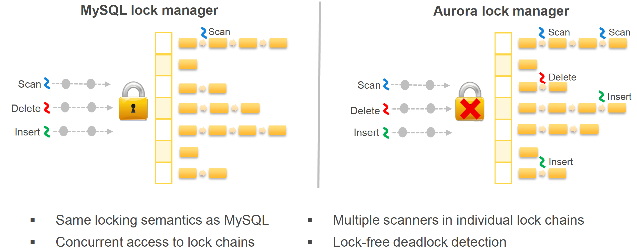
How does it achieve this performance?

Slide 15
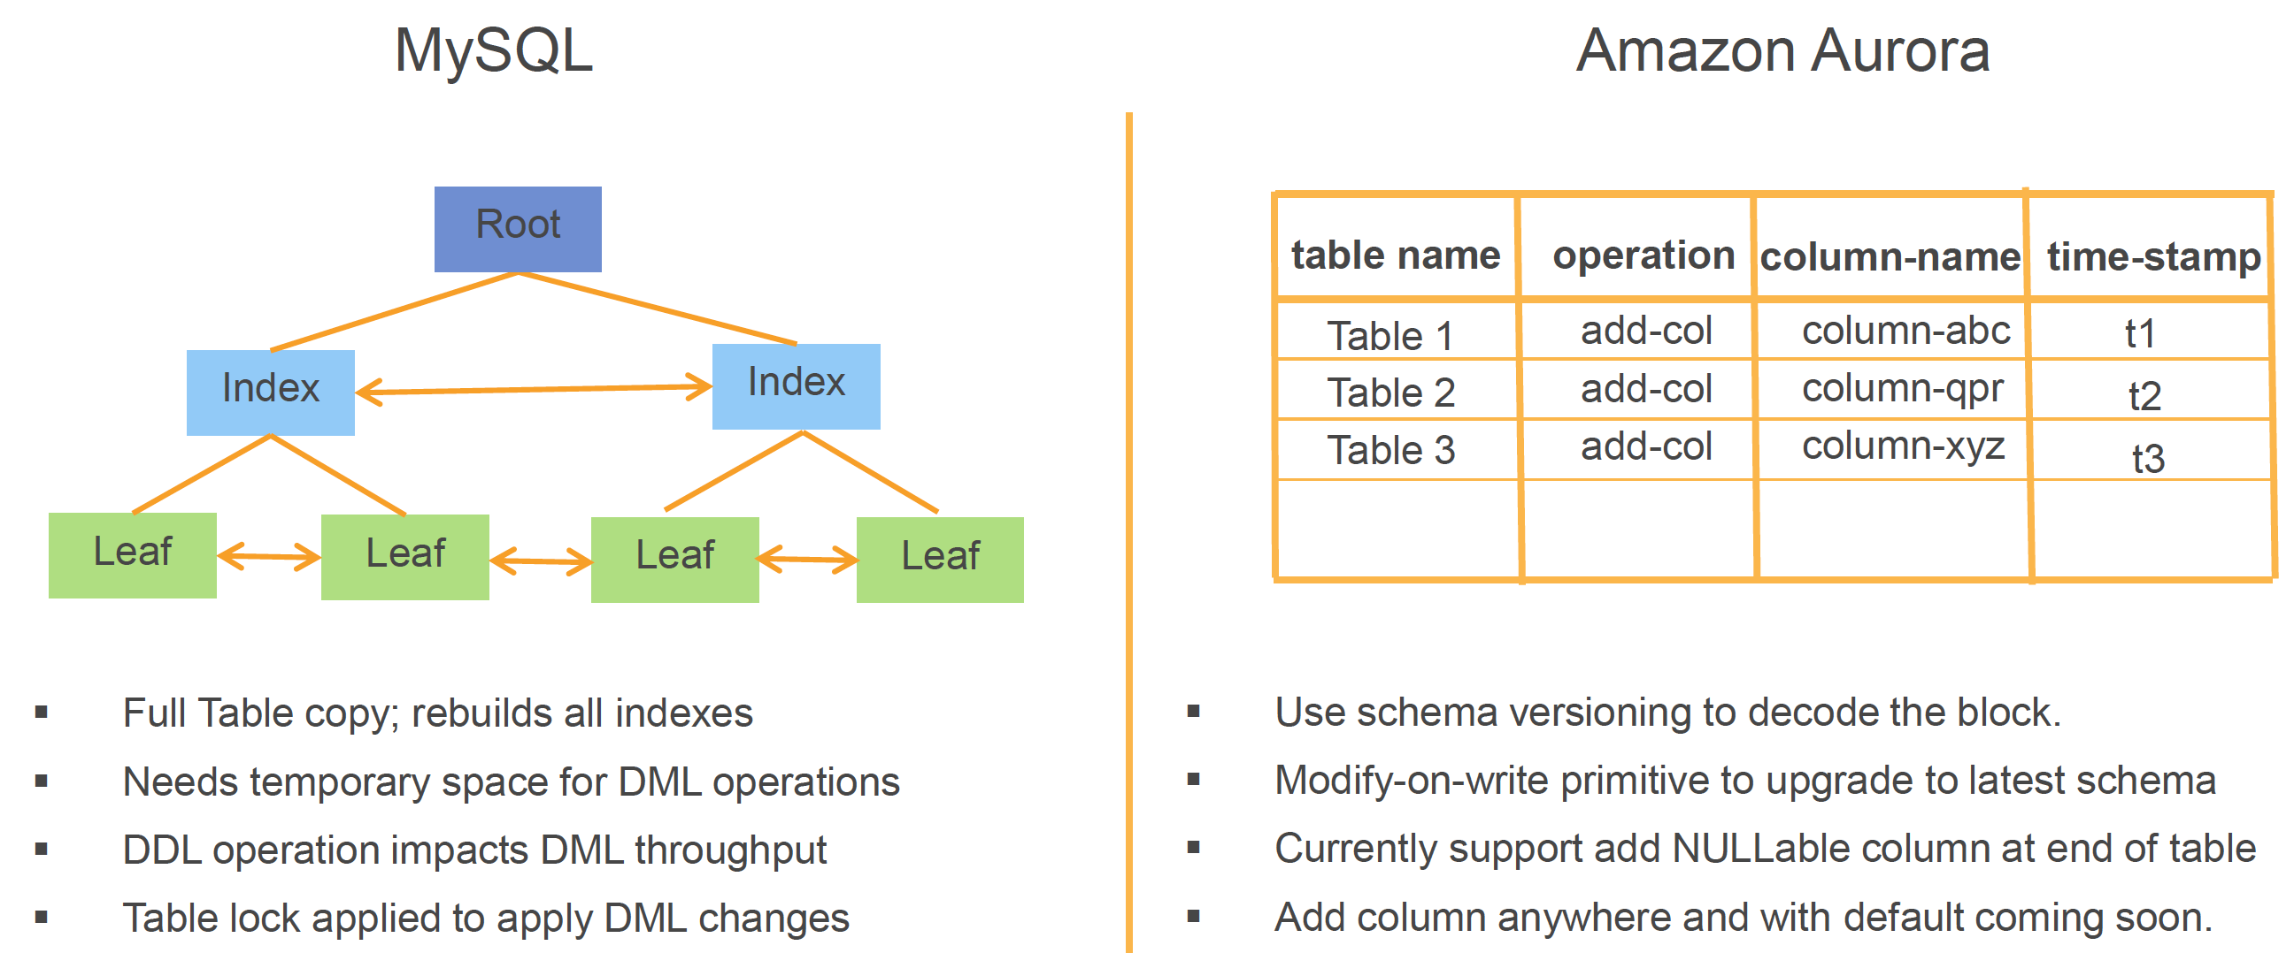
Database schema update
Uses metadata and schema versioning.

Slide 16
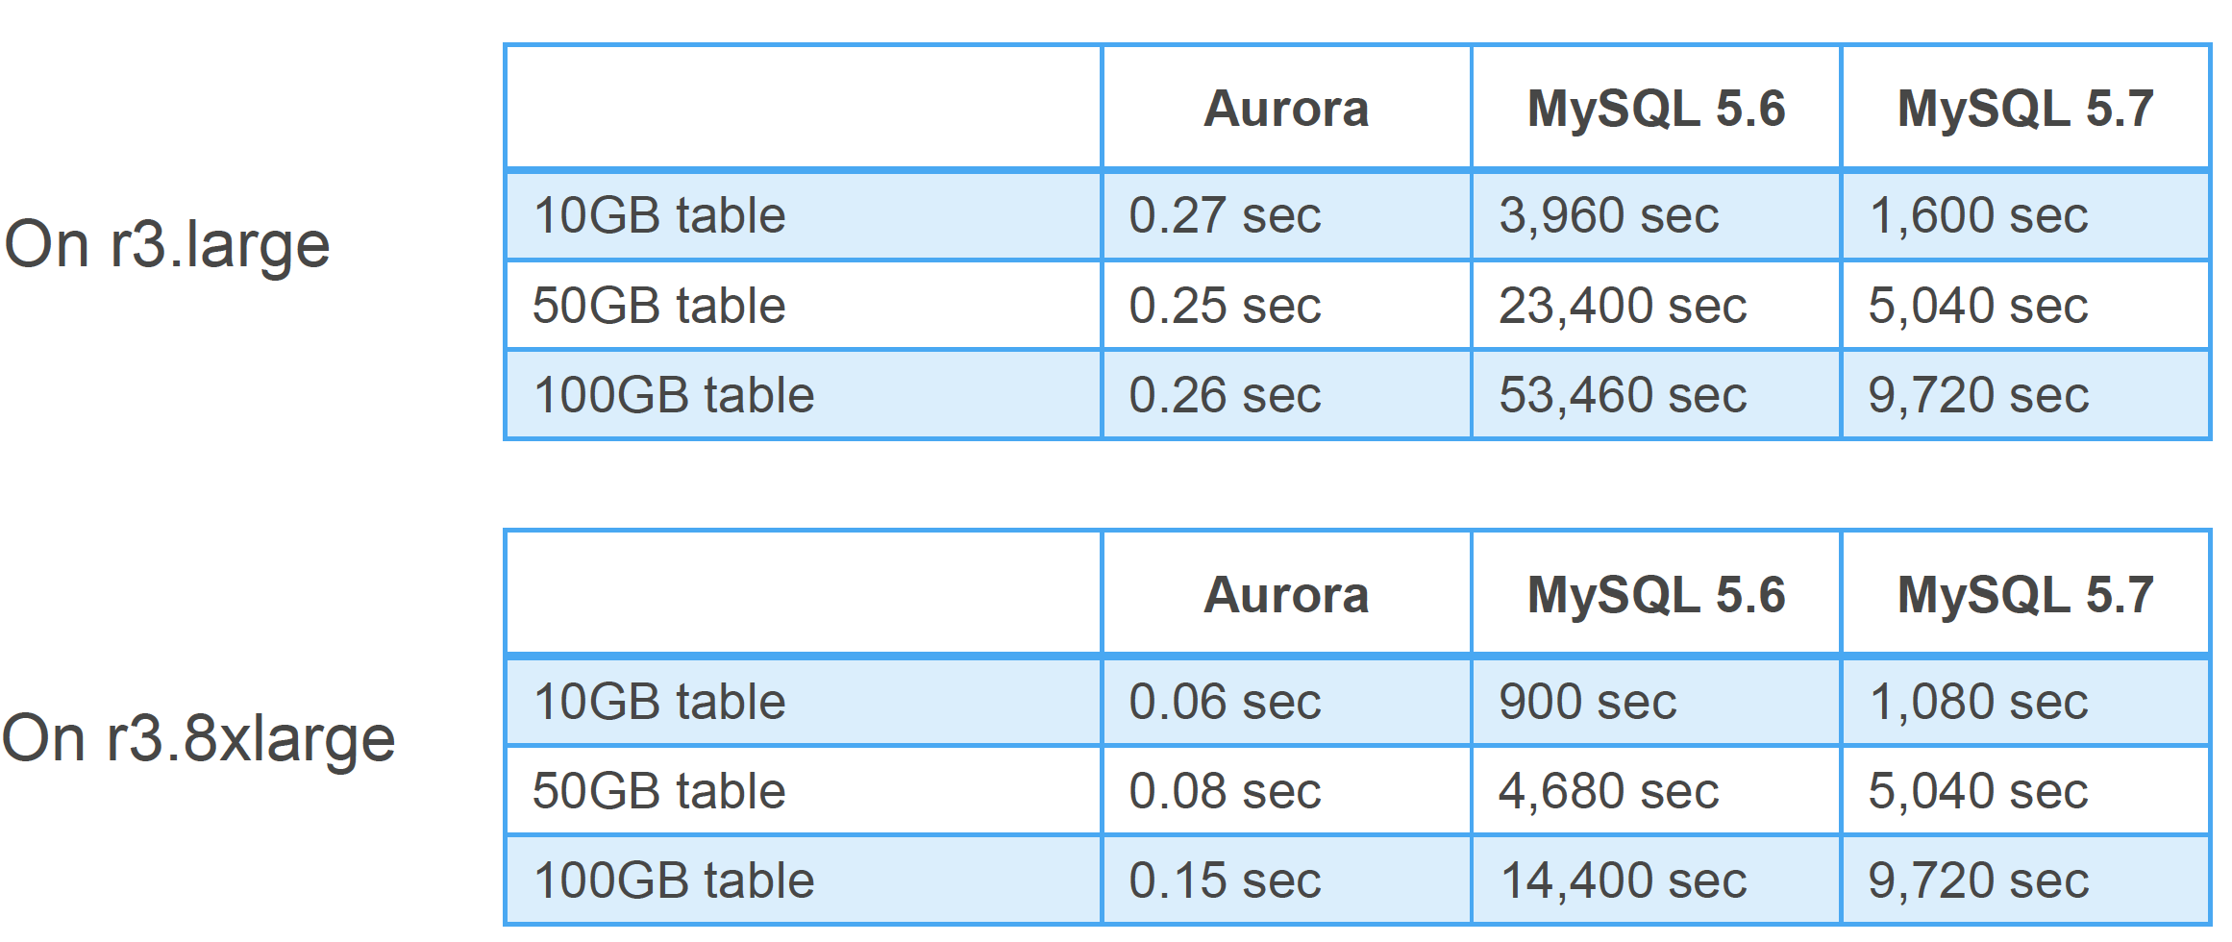
Database schema update
Performance.

Slide 17
Availability
"Performance only matters if your database is up."

Slide 18
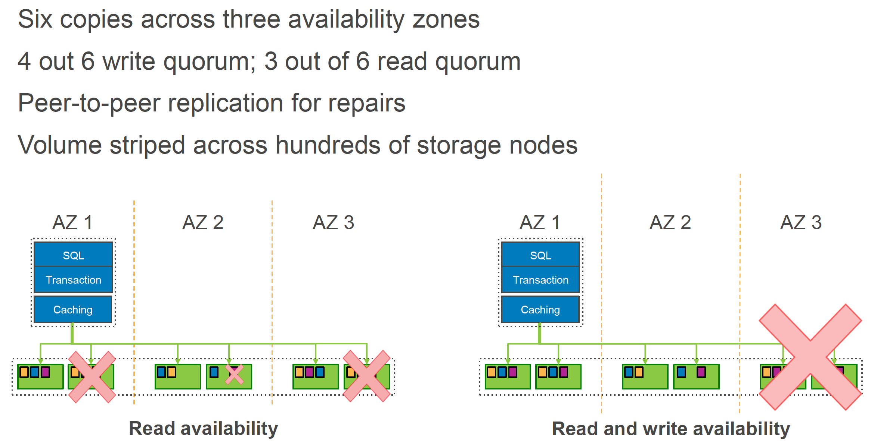
Availability

Slide 19
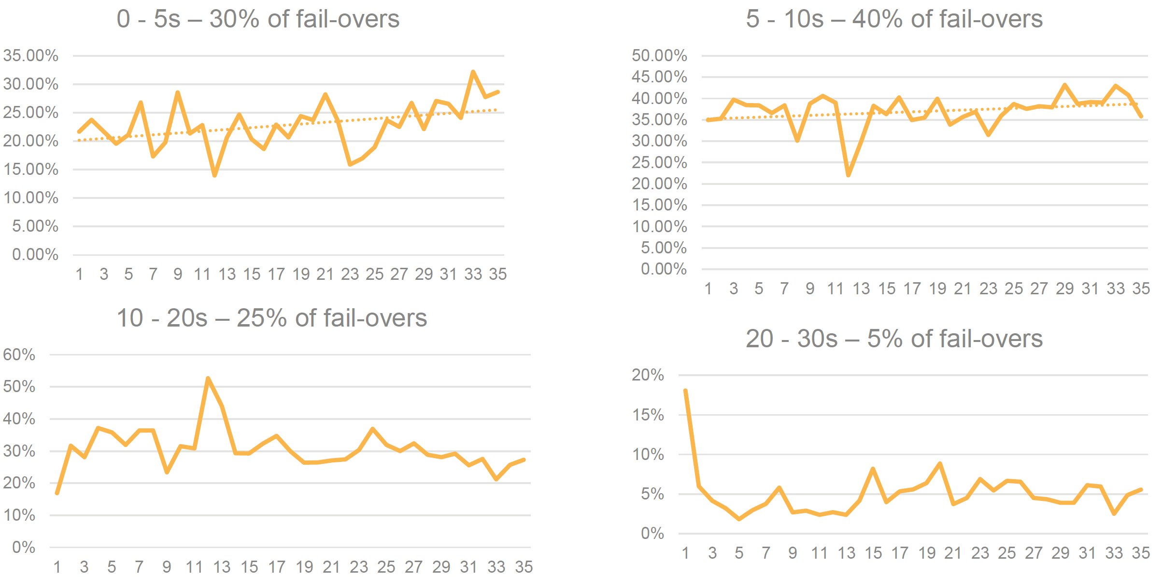
Availability
Data from the field – from entire population of databases AWS currently have.

Slide 20
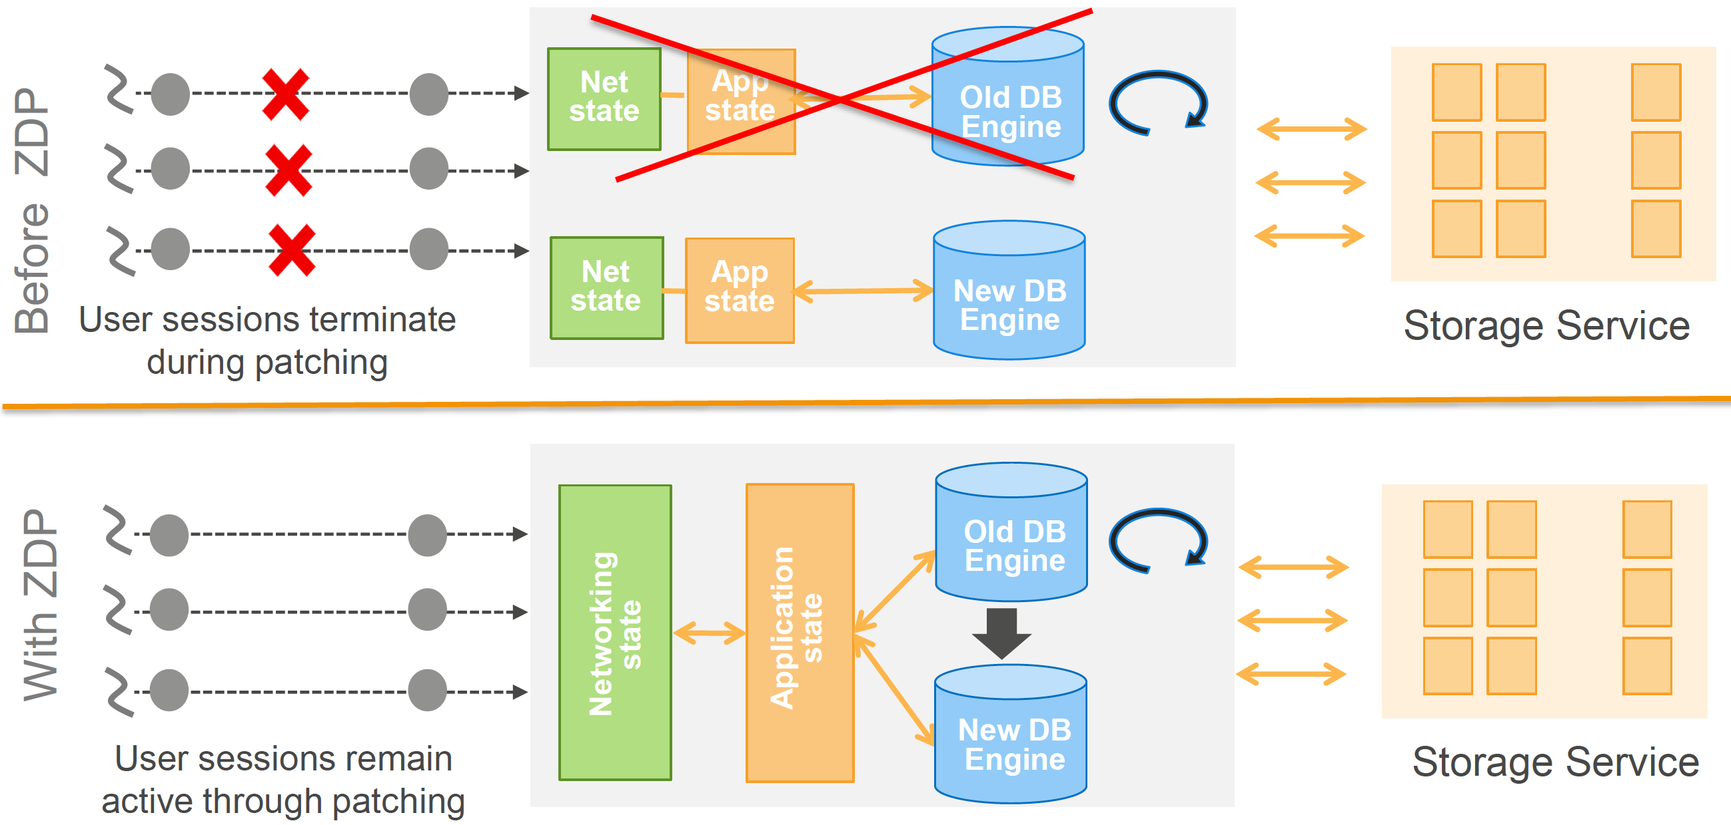
Availability
Zero Down Time Patching

Slide 21
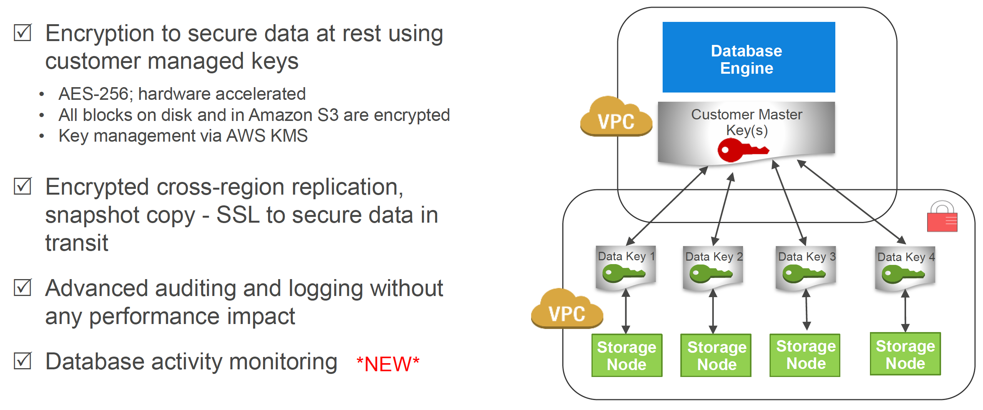
Security

Slide 22
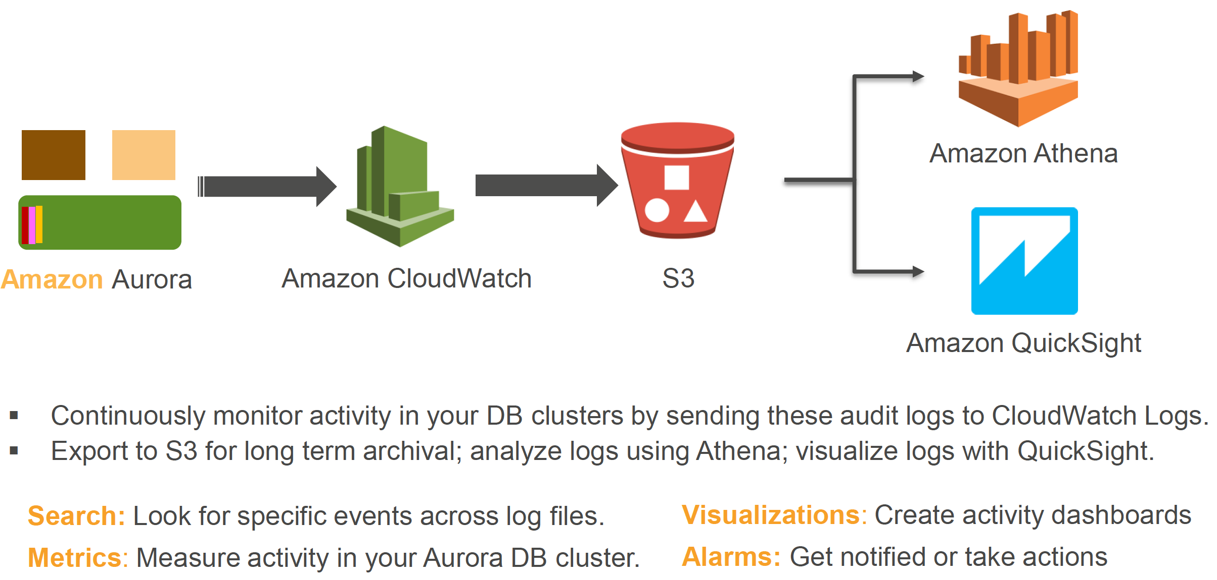
Database activity monitoring

Slide 23
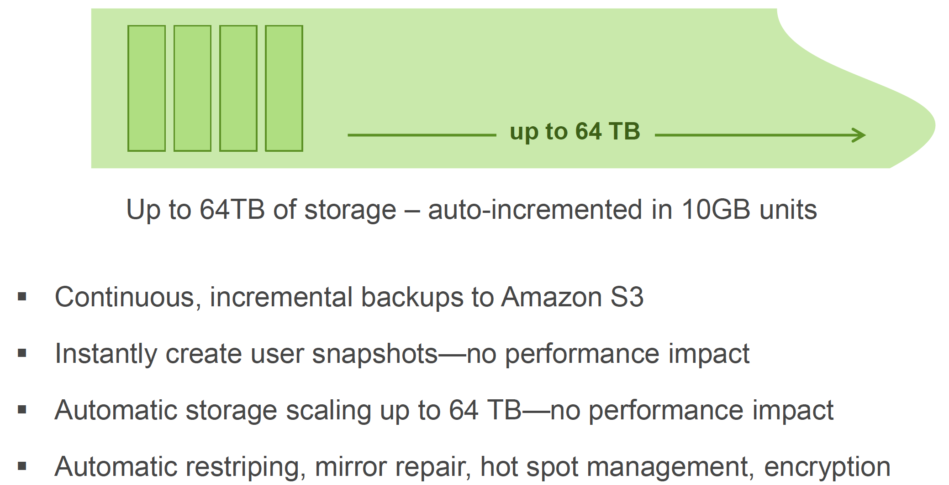
Easy to use
Simple storage management.

Slide 24
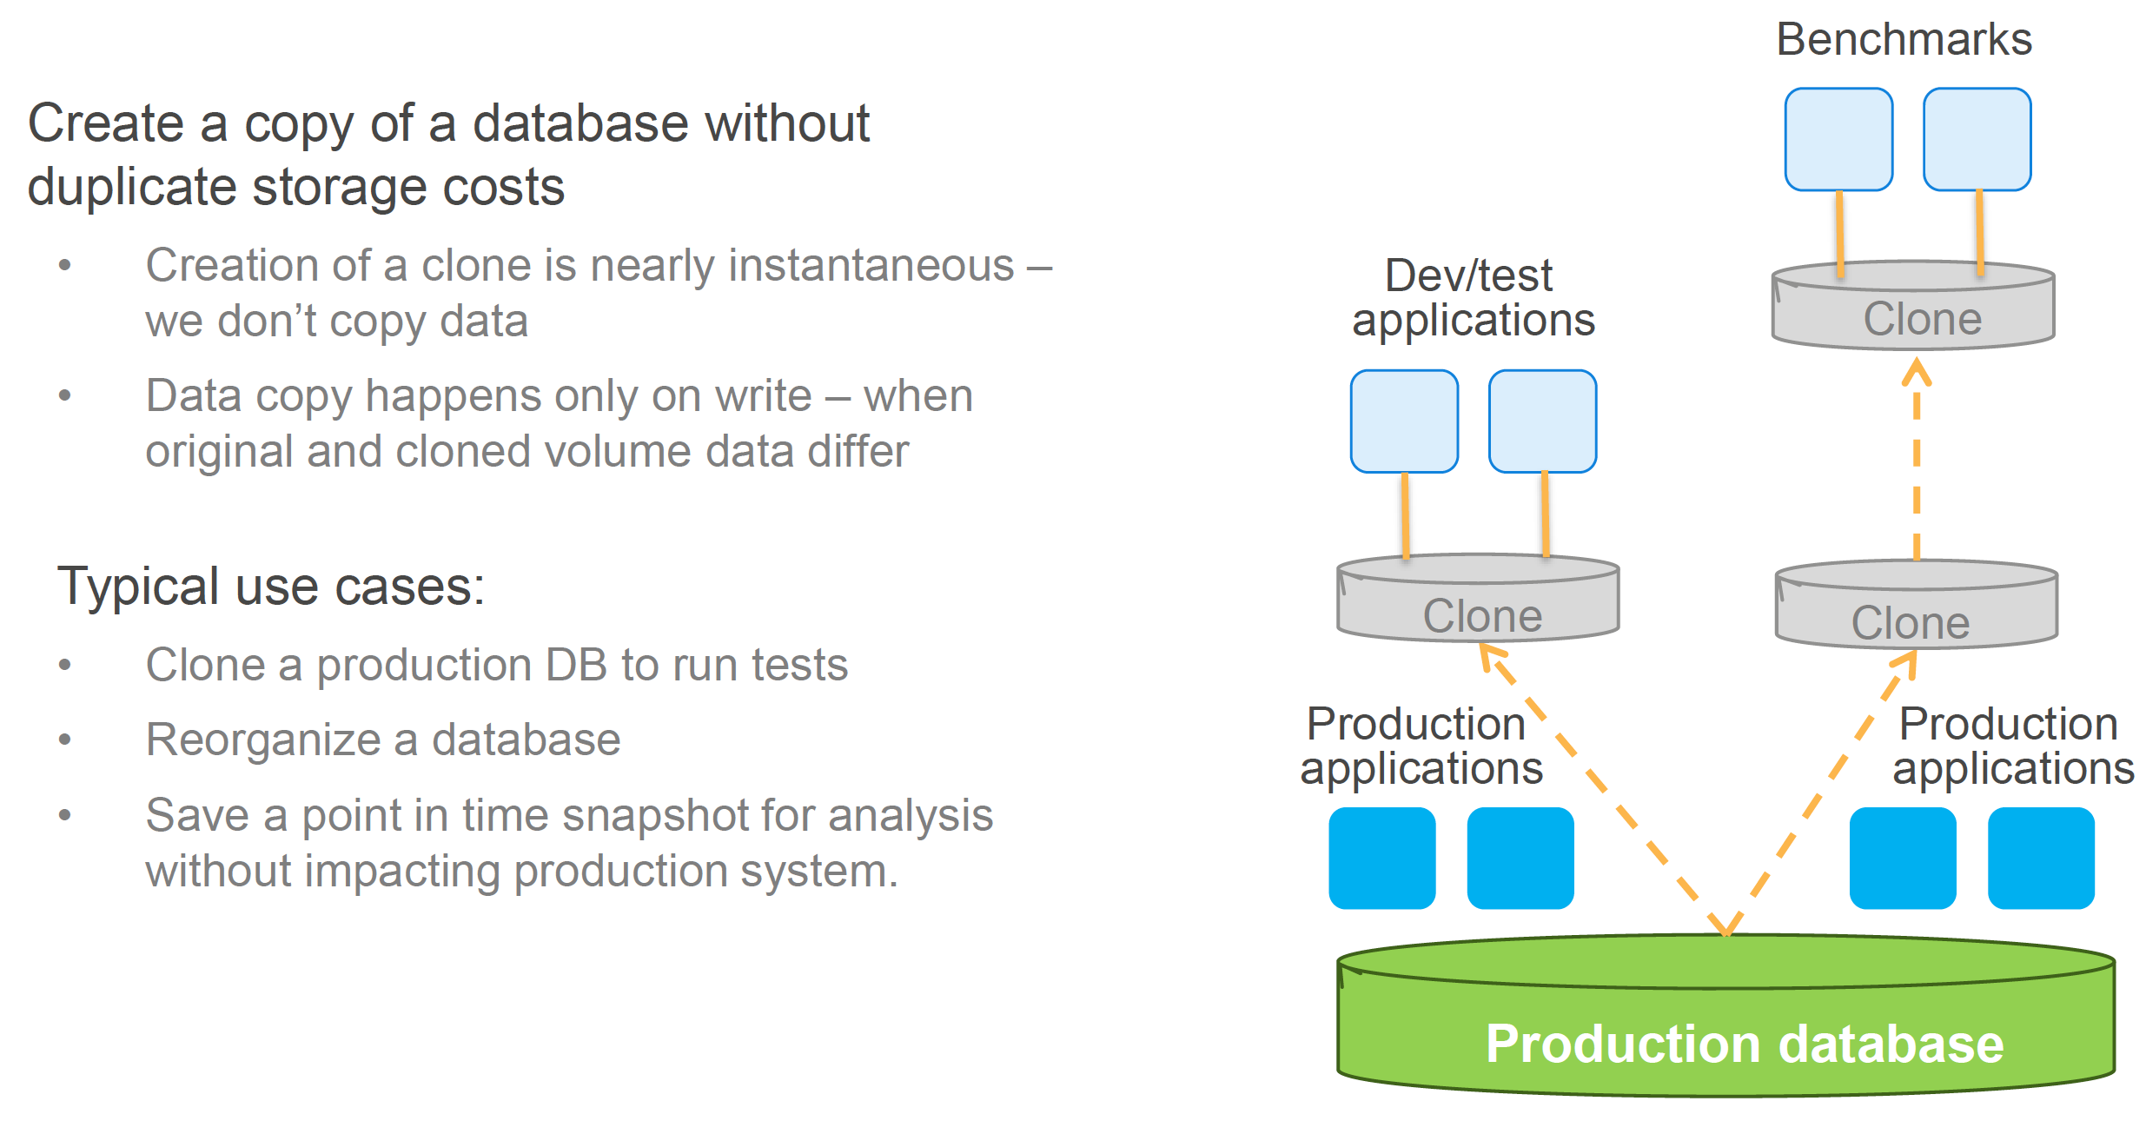
Easy to use
Fast DB cloning.

Slide 25
Cheap and cheerful
“1/10th of the price of running a commercial database, even cheaper than MySQL.”

Slide 26
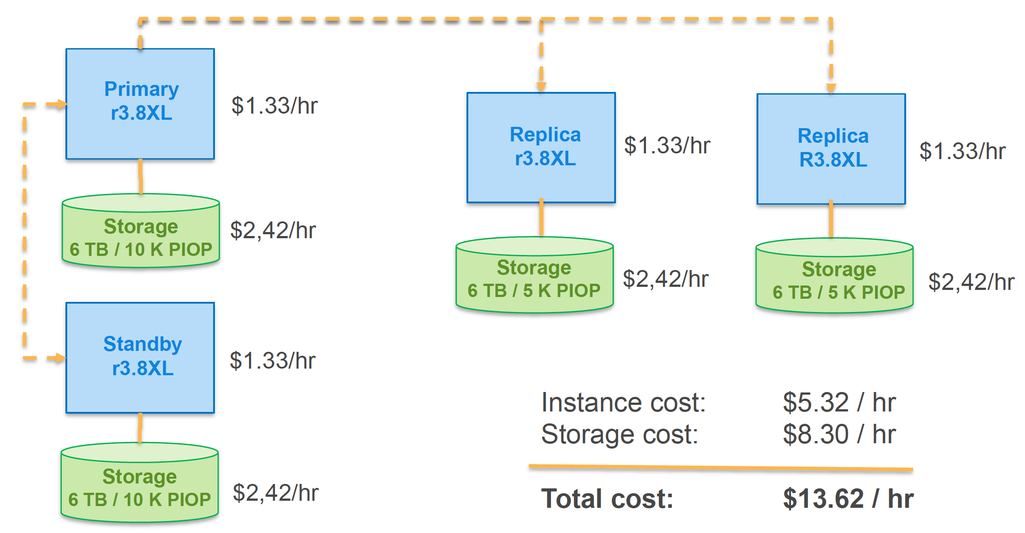
Cheap as chips
MySQL configuration per hour cost

Slide 27
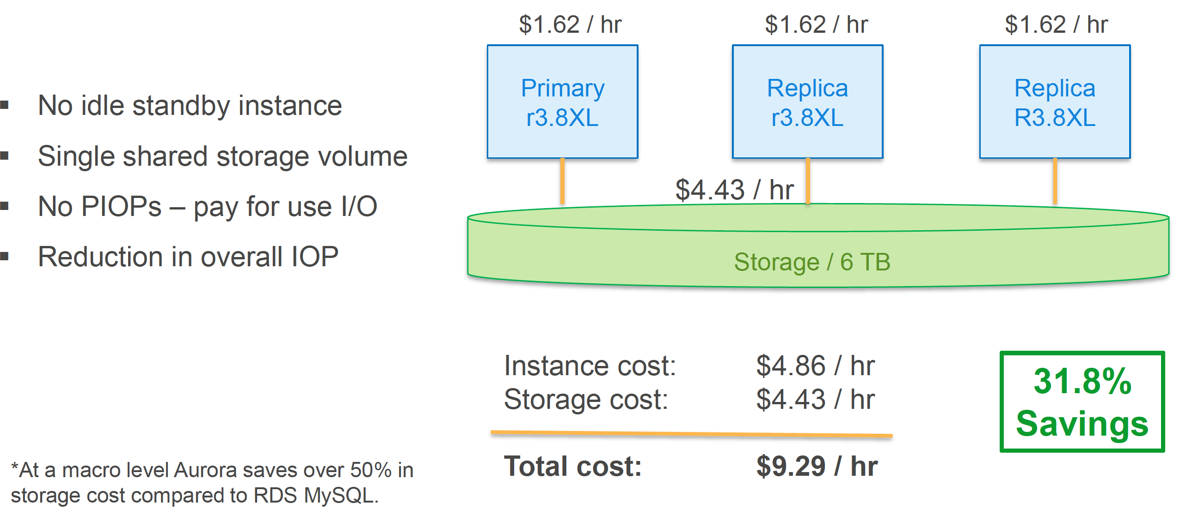
Cheap as chips
Aurora configuration per hour

Slide 28
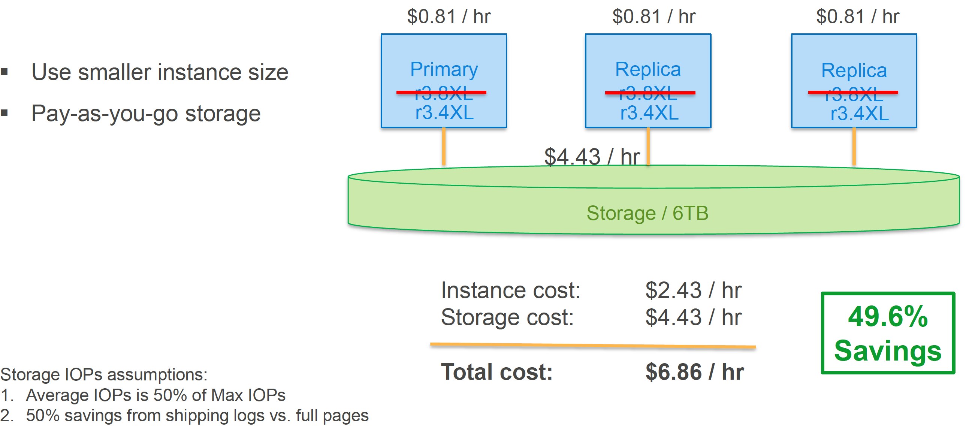
Cheap as chips
Because of Aurora’s higher performance could potentially use a smaller instances.

Slide 29
Coming soon & new
Read performance optimisations
Parallel query
Hash joins
Performance Insights
Currently available on PostreSQL
Coming soon to MySQL
Dashboards showing load on DB
Enhanced monitoring – from a lot of system metrics
Query bottleneck analysis with drill downs – what queries take most of time, is it doing it on a lock, CPU starved
Aurora Serverless

Slide 30
Questions?

Slide 31
The end
Thank you!

